Slide 1
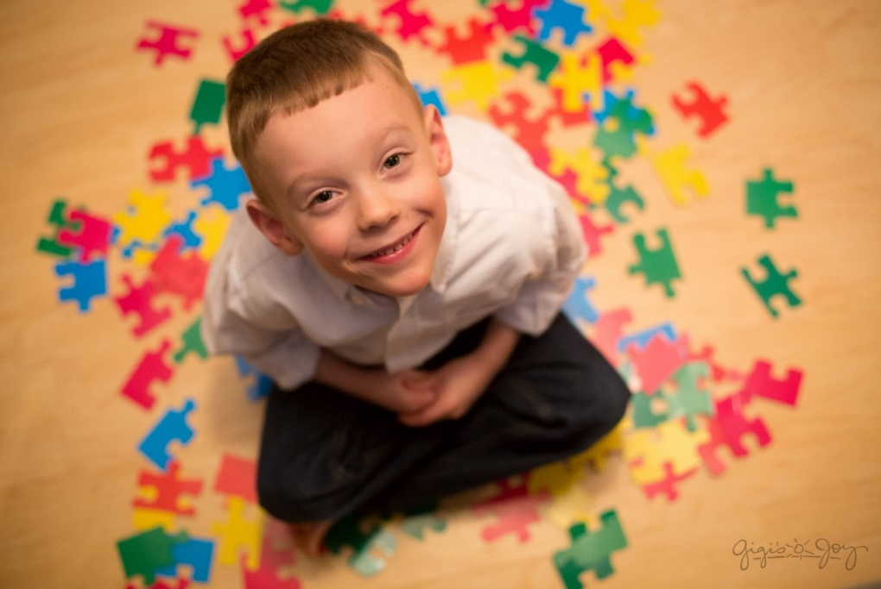
Autism Spectrum
Disorder (ASD)
By: Laura Villa

Slide 2
Definition
Autism / Autism Spectrum Disorder or ASD is a
neurodevelopmental disability characterized by significant
communication, social and behavioral challenges.
- Communication skills including unusual or delayed language.
Social skills including social relationships and interactions.
Behavior including repetitive and/or stereotyped movements & restricted interests.
People with autism handle information differently than their typically developing peers.
Autism is often referred to as a spectrum disorder
(symptoms & characteristics present themselves on a
wide spectrum from mild to severe).

Slide 3
Causes of Autism
The cause of autism has yet to be identified.
The current theories of the causes of autism include:
Genetics
Vaccines
Environmental
Structural differences in the brain.
There is no medical detection or
cure!

Slide 4
Diagnostic Statistical Manual - DSM-5 CRITERIA
In order to be diagnosed as having ASD using the Diagnostic
Statistical Manual (DSM-5) a child must:
Have persistent deficits in social communication and social
interaction across multiple contexts (few gestures; no pointing pictures in
book, toys---points to dog but not back to mom).
The severity levels are based on the amount of support needed,
due to challenges with social communication and restricted
interests and repetitive behaviors. For example: a person
might be diagnosed with Autism Spectrum Disorder, Level 1,
Level 2, or Level 3.

Slide 5
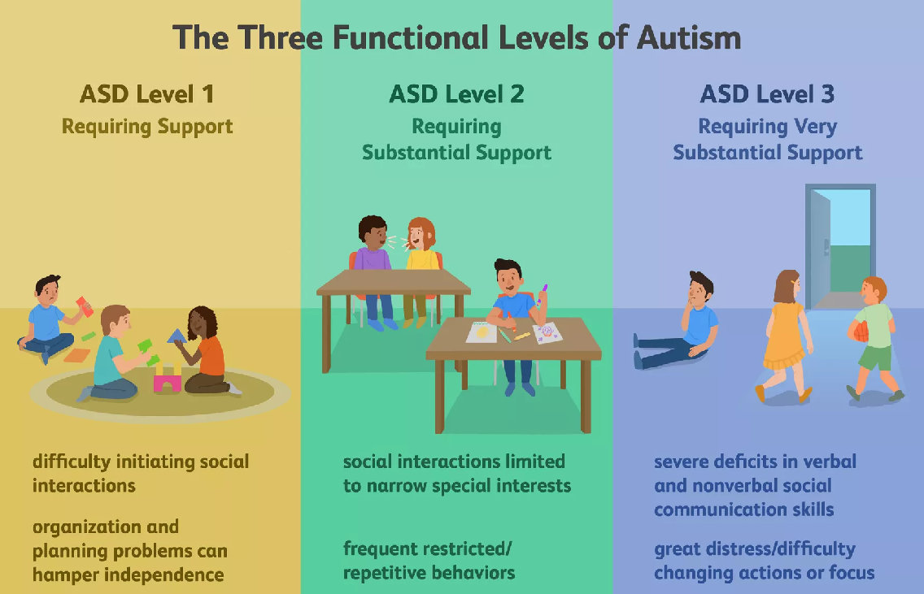

Slide 6
Facts
1 in 59 children is diagnosed with autism
Boys (1 in 37) are 4 times more likely to be diagnosed with autism than girls (1 in 151).
Autism affects all ethnic and socioeconomic groups
67 children are diagnosed per day
A new case is diagnosed every 20 minute
**More children will be diagnosed with autism this year than with AIDS, diabetes, and cancer combined (autism
is the fastest growing serious developmental disability in
the U.S.).

Slide 7
Characteristics
Communication Difficulties
- Poor or non-verbal communication; delayed; regression
language
- Echolalia or repetitive language, script language, rote language
- Unusual intonation (sing-song pattern)
- Literal, concrete
- Pointing
- Responding to name
- Initiation
- Receptive and expressive language (talk better than they
understand or vice versa)
- Pragmatic language deficits: staying on topic /
close proximity/narrow range of conversational
topics

Slide 8
Social difficulties:
Limited to fleeting eye contact
Difficulty relating to people, objects and events
Difficulty with turn taking in play
Social engagement
Joint attention
Reciprocity
Imitation
Mind blindness / theory of mind: not understanding other people perspectives/feelings (putting self in somebody else’s shoes).

Slide 9
Unusual range of behaviors, activities
and restricted interests
Challenging behaviors
Repetitive behaviors or behavior patterns - OCD type
Repetitive / stereotyped body movements (flapping, stimming/ toe walking)
Resistance to changes in routine or familiar surroundings (strong preference for sameness)
Poor /limited leisure activities/ preference for manipulating, lining up or classifying objects /unusual
play with toys or other objects
Narrow range of interest (macaroni boxes,
shapes)

Slide 10
Other known characteristics
Visual learners.
Wandering.
Broad range of intelligence.
Splinter skills (hyperlexia) / savant skills.
Up and down emotionally.
Poor incidental learners.
Unusual fears.
Unusual food – feeding habits / picky eaters.
Sensory issues / difficulty processing sensations (sight, smell, hearing, taste, touch and two more: vestibular and propioception (motor planning).

Slide 11
What Can Parents Do?
Encourage all forms of communication.
Talk to your child.
Include your child in all family events whenever possible.
Use visual supports (using schedules, routines, first-then boards, etc).
Eliminate/alter triggering events.
Partner with the school and therapists.

Slide 12
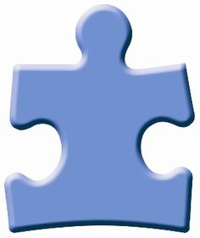
Mom and Dad
I know it’s hard at times,
Please don’t ever give up on me.
Beneath my meltdowns,
troubled talking and limited
eye contact, lies a love for you
and a bond I cannot
express right now.
I love You…
“Love your child with autism”

Slide 13
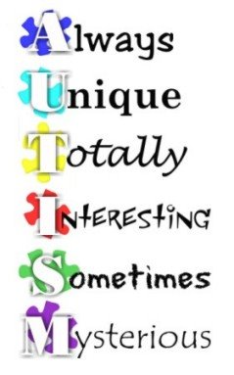

Slide 14
